Slide 1
Welcome to the fundamentals – A Quick View.
Shriram K Vasudevan

Slide 2
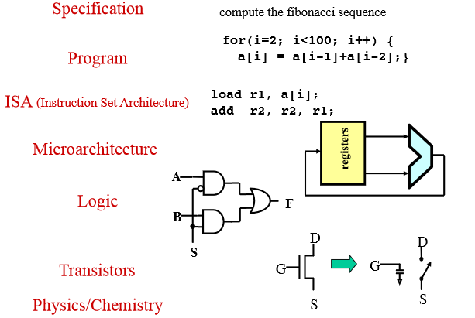
What is a computer system?

Slide 3
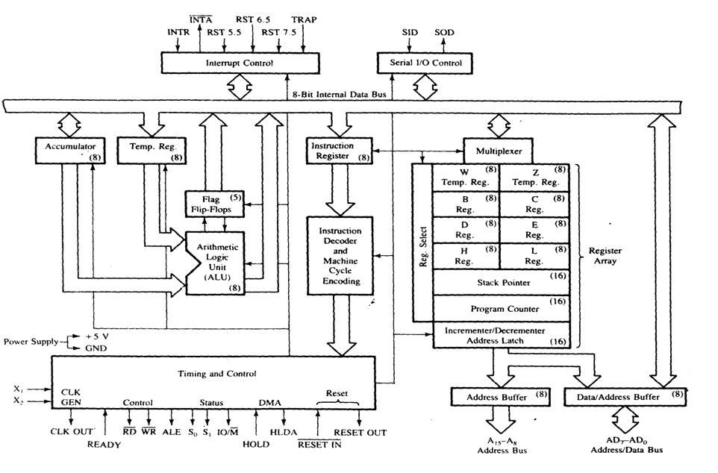

Slide 4
Now..
What is an OS?
Why do we need it?
What is an embedded system?
What is real time OS?
What is the difference between RTOS and GPOS?
Which one would you choose for which application?

Slide 5
How the structure of an OS (Say Linux) look like?
Look @ the PPT. This is very very important!

Slide 6
Thanks
Shriram K V
shriramkv@gmail.com

